Slide 1








presents

Slide 2



PARA -
ARCHERY

Slide 3


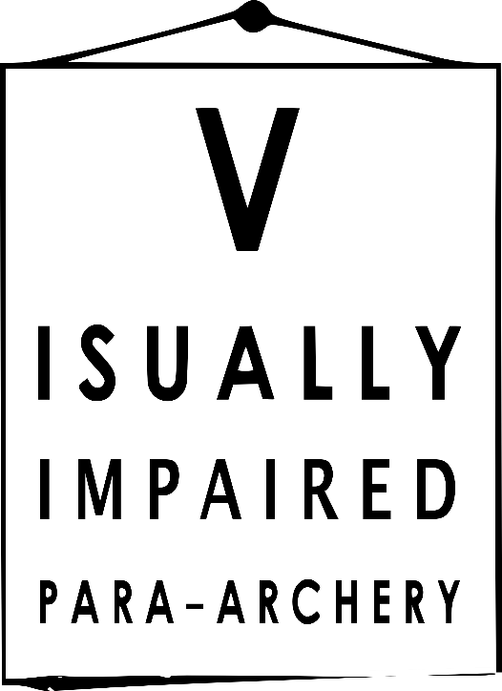

PARA -
ARCHERY

Slide 4
INTRODUCTION

Slide 5








For impaired archers, first of all, we must define:
the kind of impairment
if the impairment affects shooting
how much it affects shooting
if an assistive device is necessary to enable the person to shoot. However it must not give an unfair advantage
which impairments can be grouped together
  (for instance, could a blind archer compete against an archer with no arms ?)
This is the aim of the
CLASSIFICATION

Slide 6

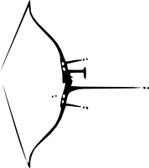
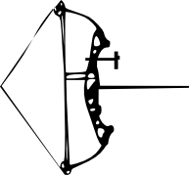

For able bodied archers, people who compete are grouped by:
gender
the kind of bow they use
age

Slide 7


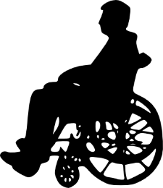
For impaired archers, people who compete are grouped by:
type and level of impairment
gender
type of bow they use

Slide 8
CLASSIFICATION

Slide 9
Visual impairments
Vision Impairment occurs when there is damage to one or more of the components of the vision system, which can include impairment of:
the eye structure/receptors
the optic nerve/optic pathways
the visual cortex
The determination of visual class is based upon the eye with better visual acuity while wearing best optical correction using spectacles or contact lenses, and/or Visual Fields which include central and peripheral zones.

Slide 10
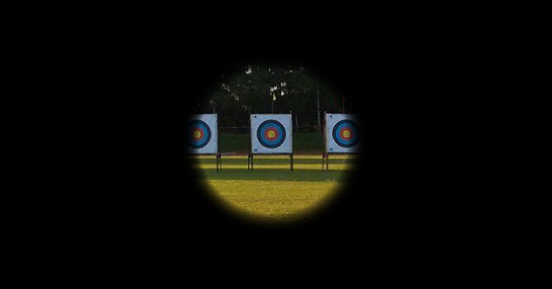
Just as physically impairment, the class is determined by the effect on the ability to do the sport.
For instance, a tubular vision with normal visual acuity
could be an impairment for skiing but an advantage for archery with compound bow

Slide 11

Visual impairments classes based on IBSA* Sport Classes
B1 | Visual acuity poorer than LogMAR 2.60
(*) International Blind Sports Federation

Slide 12

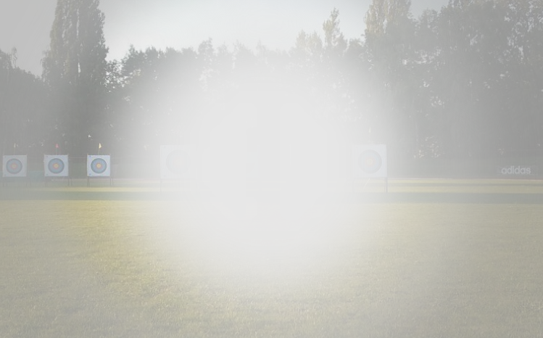
Visual impairments classes based on IBSA* Sport Classes
B2 | Visual acuity ranging from LogMAR 1.50 to 2.60 (inclusive) and/or visual field constricted to a diameter of less than 10 degrees.
(*) International Blind Sports Federation

Slide 13
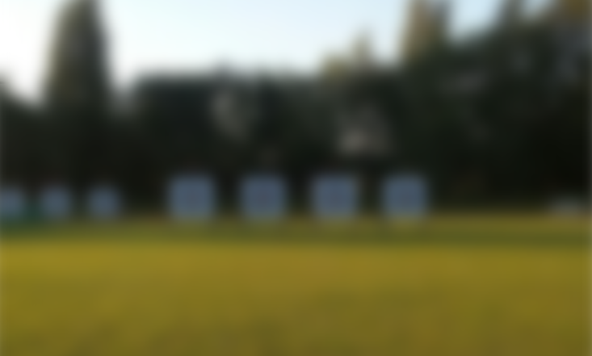
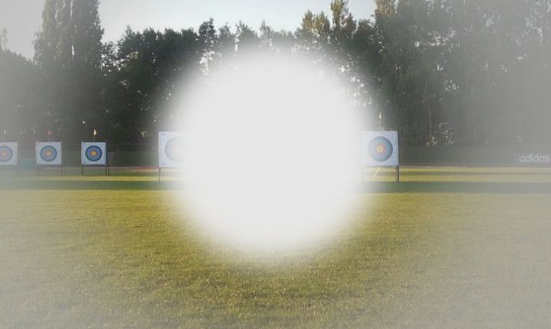
Visual impairments classes based on IBSA* Sport Classes
B3 | Visual acuity ranging from LogMAR 1.40 to 1 (inclusive) and/or visual field constricted to a diameter of less than 40 degrees.
(*) International Blind Sports Federation

Slide 14
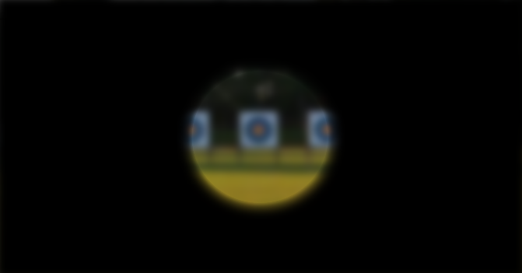
Visual impairments classes based on IBSA* Sport Classes
B3 | Visual acuity ranging from LogMAR 1.40 to 1 (inclusive) and/or visual field constricted to a diameter of less than 40 degrees.
(*) International Blind Sports Federation

Slide 15

Visual impairments classes based on IBSA* Sport Classes
NE | When the visual acuity is not enough poor, the archer is considered as NON-ELIGIBLE and cannot compete as Para-Archer.
(*) International Blind Sports Federation

Slide 16
CATEGORIES

Slide 17
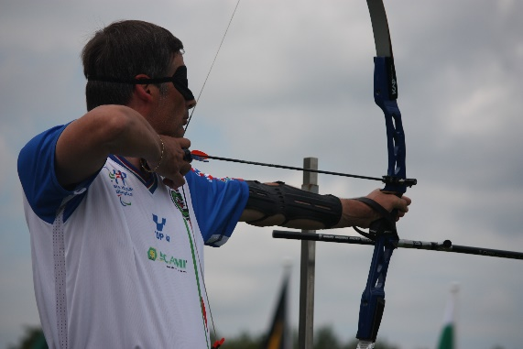
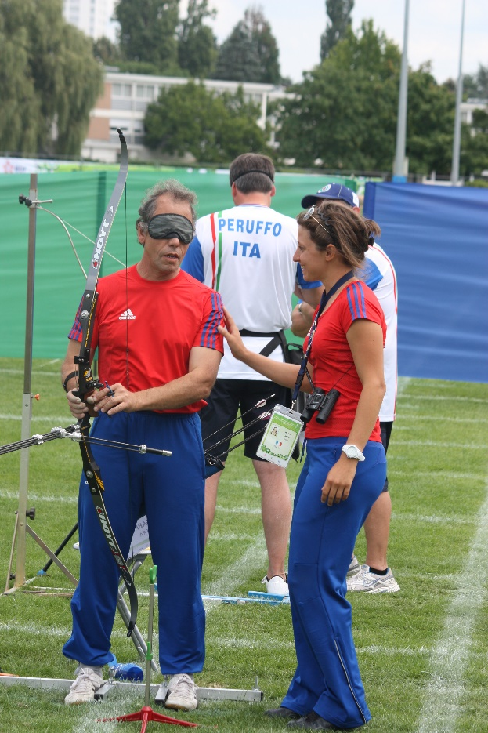
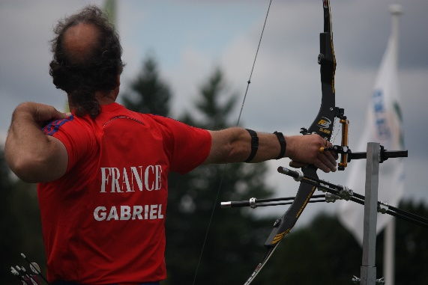

Slide 18


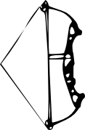

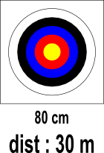


Visual impairments
VI1 Visually Impaired 1 | IBSA Class B1
VI2/3 Visually Impaired 2 and 3 | IBSA Class B2 B3
≤ 45 lbs
≤ 45 lbs

Slide 19


Visual impairments
Official international categories
V.I. 1 | Individual Men/Women Mixed Team Team Men/Women | ✓ ✗ ✗ | ✗ ✗ ✗
V.I. 2/3
IPC

Slide 20
CHALLENGES

Slide 21

The Para-Archery Committee is happy to have Visually Impaired Persons as new members of the ARCHERY family.
This new membership means new challenges for:
World Archery
WA Member Associations
Organizers of international events
To succeed, World Archery is working with the helpful and efficient cooperation of the
International Blind Sports Federation

Slide 22
Challenges for World Archery
to clarify the VI classes in the classification handbook
to create a master-list of VI archers in the WA data-base
to have cooperation with IBSA about knowledge and participation of classifiers
Challenges for WA member associations
to promote archery for Visually Impaired persons
to have agreements with national associations in charge of VI Sport organizations
to contribute to selection and participation of VI archers in International tournaments

Slide 23
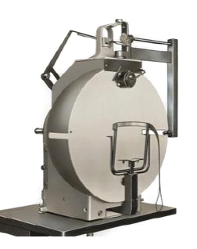
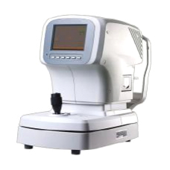
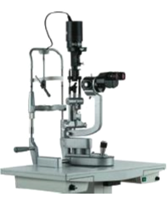
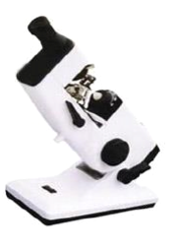
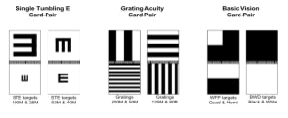
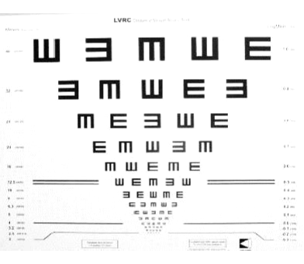
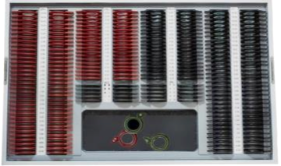
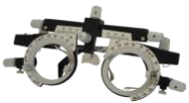
Challenges for organizers of international events in Para-Archery
to integrate VI categories like the other categories
to host VI classification
The last point is probably the most difficult because of the following needs :
specific rooms (such as an ophthalmologist office)
specific professional equipment

Slide 24
VI classification for the World Championships
Thanks to
the LOC of the Para World Championships in Donaueschingen
the IBSA who had appointed classifiers for the event
the University Ophthalmologist Clinic of Freiburg im Breisgau who accepted to host the classification session
World Archery will organize the first official classification for VI archers
Regarding on the preliminary entries, the number of archers is enough to organize elimination rounds and finals, and titles could be delivered in both VI categories.

Slide 25
On behalf of the Para-Archery Committee,
I thank you in advance for
your willingness to integrate
Visually Impaired Persons in the Archery Family …
Thank you for your attention.

Slide 26
PARA -
ARCHERY

